Slide 1
Battery Model Summary
Jules Pare

Slide 2
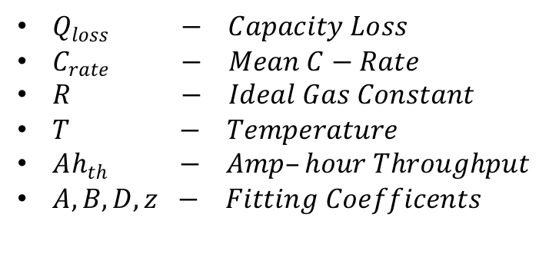
Arrhenius Correlation Amp-hour Throughput Model
$$Q_{loss}=A\exp\left[\frac{−E_{a}+BC_{rate}}{RT}\right] {Ah}_{th}^{z}$$
$Q_{loss} − Capacity Loss$
$C_{rate} − Mean C−Rate$
$R − Ideal Gas Constant$
$T − Temperature$
$Ah_{th} − Amp–hour Throughput$
$A,B,D, z − Fitting Coefficents$
L. Chen, Y. Tong, and Z. Dong, “Li-Ion Battery Performance Degradation Modeling for the Optimal Design and Energy Management of Electrified Propulsion Systems,” Energies, vol. 13, no. 1629, p. 1629, Apr. 2020, doi: 10.3390/en13071629.

Slide 3
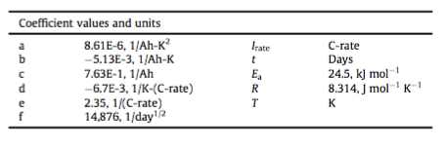
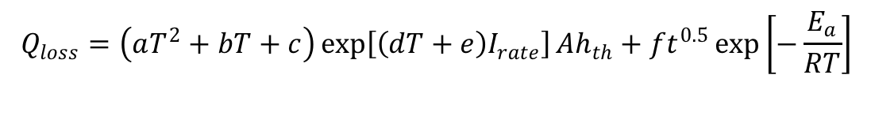
Second-Order Arrhenius Amp-Hour Throughput
$$Q_{loss}=\left(aT^{2}+bT+c\right)\exp\left[\left(dT+e\right)I_{rate}\right]Ah_{th}+ft^{0.5}\exp\left[−\frac{E_{a}}{RT}\right]$$
J. Wang et al., “Degradation of lithium ion batteries employing graphite negatives and nickel–cobalt–manganese oxide + spinel manganese oxide positives: Part 1, aging mechanisms and life estimation,” J. Power Sources, vol. 269, pp. 937–948, Dec. 2014, doi: 10.1016/j.jpowsour.2014.07.030.

Slide 4
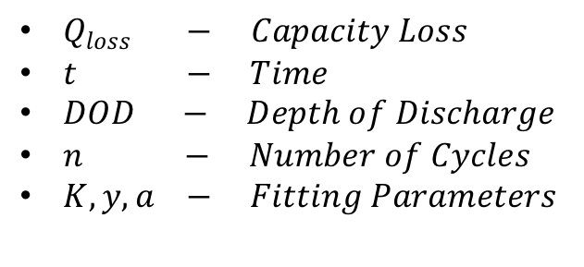
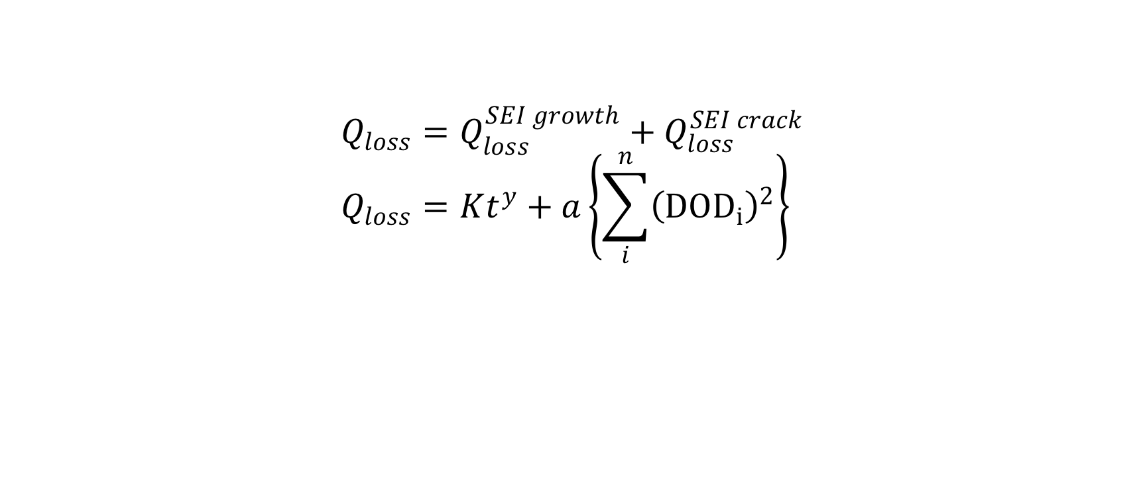
Deshpande-Bernardi Model
$$Q_{loss}=Q_{loss}^{SEI growth}+Q_{loss}^{SEI crack} \\ Q_{loss}=Kt^{y}+a\left\{\sum_{i}^{n}{{\left({DOD}_{i}\right)}^{2}}\right\}$$
$Q_{loss} − Capacity Loss$
$t − Time$
$DOD − Depth of Discharge$
$n − Number of Cycles$
$K,y,a − Fitting Parameters$
R. D. Deshpande and K. Uddin, “Physics inspired model for estimating ‘cycles to failure’ as a function of depth of discharge for lithium ion batteries,” J. Energy Storage, vol. 33, p. 101932, Jan. 2021, doi: 10.1016/j.est.2020.101932.

Slide 5
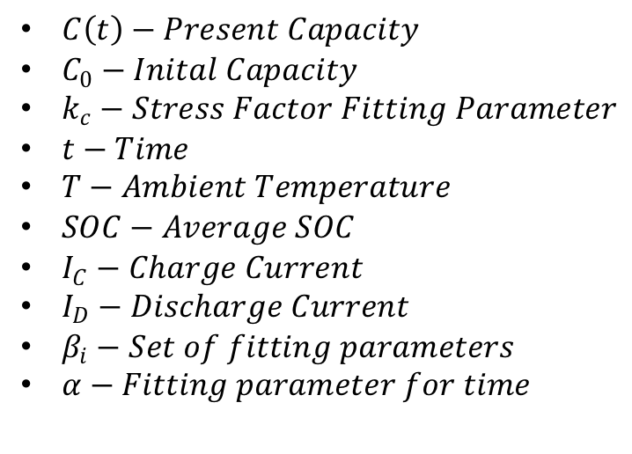
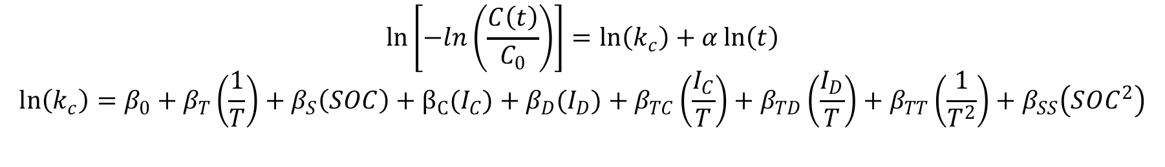
Quadradic Approximation Model
$$\ln\left[−ln\left(\frac{C\left(t\right)}{C_{0}}\right)\right]=\ln\left(k_{c}\right)+α\ln\left(t\right)$$
$$\ln\left(k_{c}\right)=β_{0}+β_{T}\left(\frac{1}{T}\right)+β_{S}\left(SOC\right)+β_{C}(I_{C})+β_{D}(I_{D})+β_{TC}\left(\frac{I_{C}}{T}\right)+β_{TD}\left(\frac{I_{D}}{T}\right)+β_{TT}\left(\frac{1}{T^{2}}\right)+β_{SS}\left(SOC^{2}\right)$$
$C\left(t\right)−Present Capacity$
$C_{0}−Inital Capacity$
$k_{c}−Stress Factor Fitting Parameter$
$t−Time$
$T−Ambient Temperature$
$SOC−Average SOC$
$I_{C}−Charge Current$
$I_{D}−Discharge Current$
$β_{i}−Set of fitting parameters$
$α−Fitting parameter for time$
D. Galatro, C. D. Silva, D. A. Romero, O. Trescases, and C. H. Amon, “Challenges in data-based degradation models for lithium-ion batteries,” Int. J. Energy Res., vol. 44, no. 5, pp. 3954–3975, 2020, doi: https://doi.org/10.1002/er.5196.

Slide 6
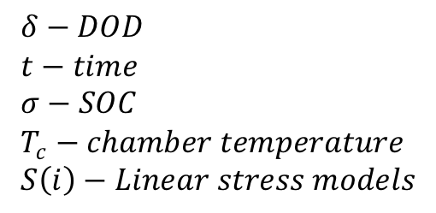
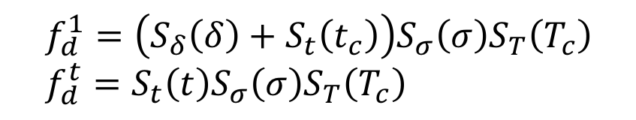
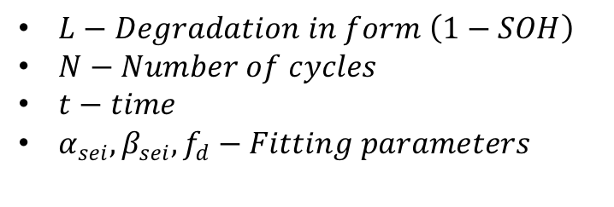
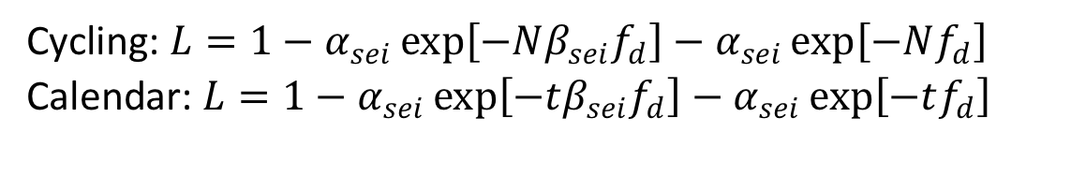
Nonlinear model with linear stress factors
Cycling: $L=1−α_{sei}\exp\left[−Nβ_{sei}f_{d}\right]−α_{sei}\exp\left[−Nf_{d}\right]$
Calendar: $L=1−α_{sei}\exp\left[−tβ_{sei}f_{d}\right]−α_{sei}\exp\left[−tf_{d}\right]$
$L−Degradation in form \left(1−SOH\right)$
$N−Number of cycles$
$t−time$
$α_{sei},β_{sei},f_{d}−Fitting parameters$
$$f_{d}^{1}=\left(S_{δ}\left(δ\right)+S_{t}\left(t_{c}\right)\right)S_{σ}\left(σ\right)S_{T}\left(T_{c}\right) \\ f_{d}^{t}=S_{t}\left(t\right)S_{σ}\left(σ\right)S_{T}\left(T_{c}\right)$$
$$δ−DOD \\ t−time \\ σ−SOC \\ T_{c}−chamber temperature \\ S\left(i\right)−Linear stress models$$
B. Xu, A. Oudalov, A. Ulbig, G. Andersson, and D. S. Kirschen, “Modeling of Lithium-Ion Battery Degradation for Cell Life Assessment,” IEEE Trans. Smart Grid, vol. 9, no. 2, pp. 1131–1140, Mar. 2018, doi: 10.1109/TSG.2016.2578950.

Slide 7
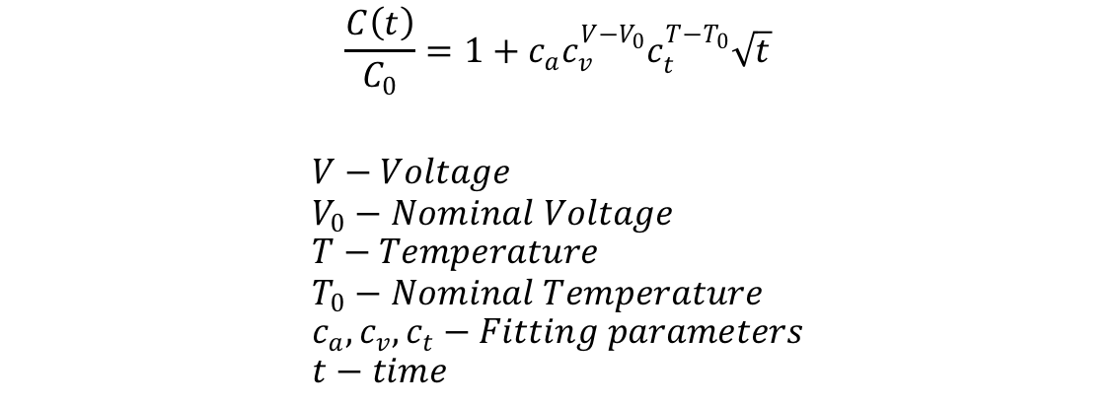
Model with EC and Thermal Model
$$\frac{C\left(t\right)}{C_{0}}=1+c_{a}c_{v}^{V−V_{0}}c_{t}^{T−T_{0}}\sqrt{t}$$ $$V−Voltage \\ V_{0}−Nominal Voltage \\ T−Temperature \\ T_{0}−Nominal Temperature \\ c_{a},c_{v},c_{t}−Fitting parameters \\ t−time$$

